Slide 1
Figure 1

Slide 2
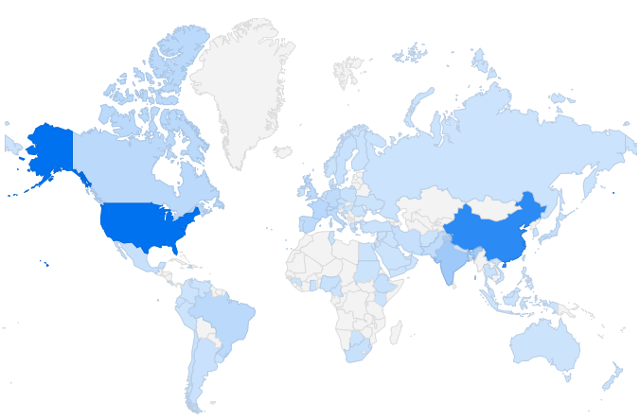

Figure 2
Geographic location of applicants by country
United States,
28.6%
China,
22.6%
India,
6.5%

Slide 3
Figure 3

Slide 4
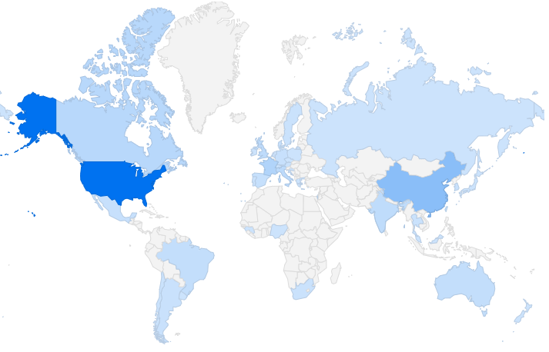

Figure 4
Geographic location of selected Editors by country
France,
5.7%
United States,
41.5%
China,
13.6%

Slide 5
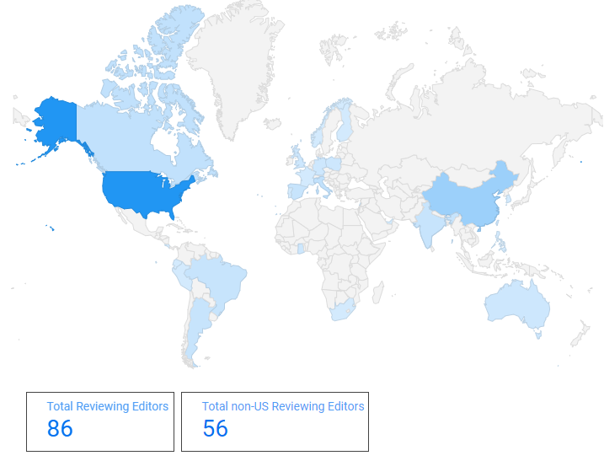
Figure 5
Geographic location of Reviewing Editors by country
Finland
Costa Rica
Ecuador
St. Kitts and Nevis
Peru
The Philippines
Ghana

